Slide 1

Financial Transactions
The analysis

Slide 2
1. Insights In case you want to skip the technical stuff

Slide 3
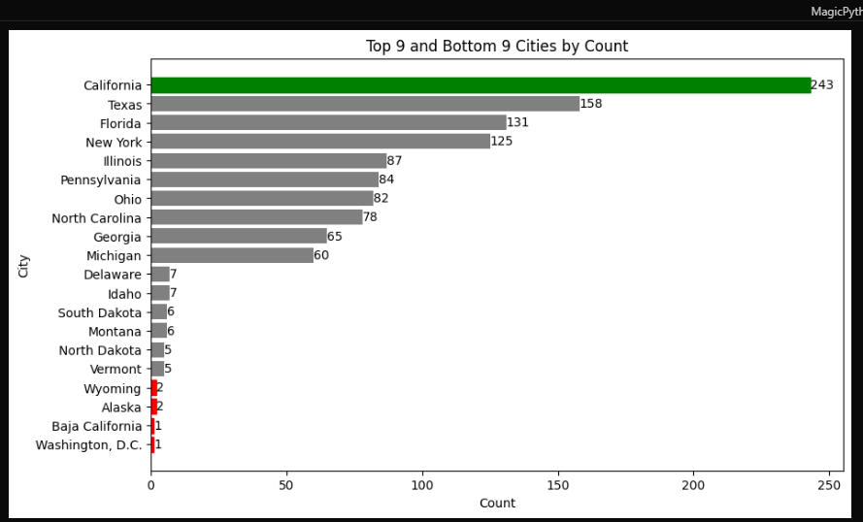
Top and bottom cities
Users counts are low in cities like Delaware ,idaho, southdakota ,Washington DC
Advertisement campaigns in Washington would greatly increase number of users

Slide 4
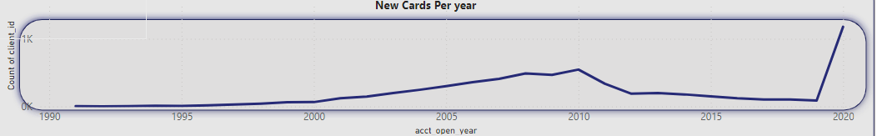
Cards issued
cards increased by 1178 new card in the first 2 months of 2020, whatever they did, it worked, we also notice an increase of total number of users, as we have get 729 new users

Slide 5
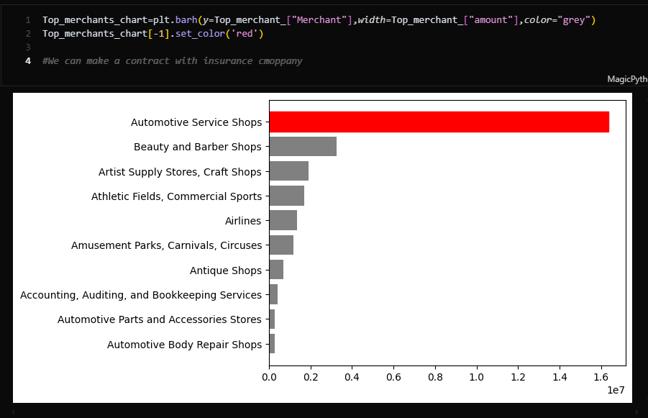
Spent on merchants
Over the last 10 years, people spent HUGE amounts on automotive service shops.
Partnership with insurance companies might be useful

Slide 6
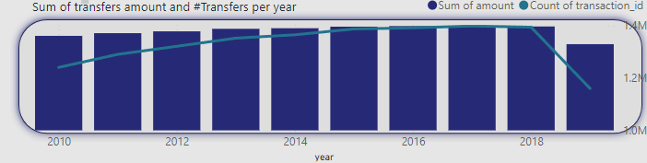
Transfers- counts/amount
Total transfer amounts/count increased over the span of the last 10 years despite this drop, as it is caused by not having sufficient data for 2020 year

Slide 7
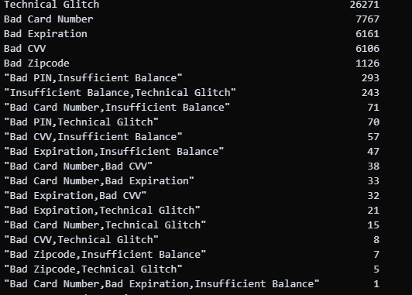
Errors errors are mostly due to user issue,however we can see alot of tech glitches

Slide 8
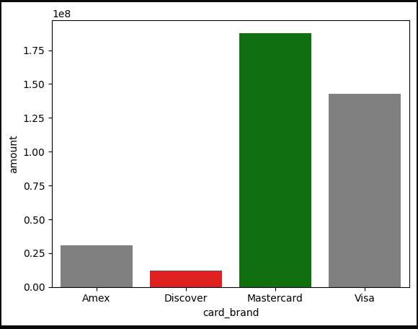
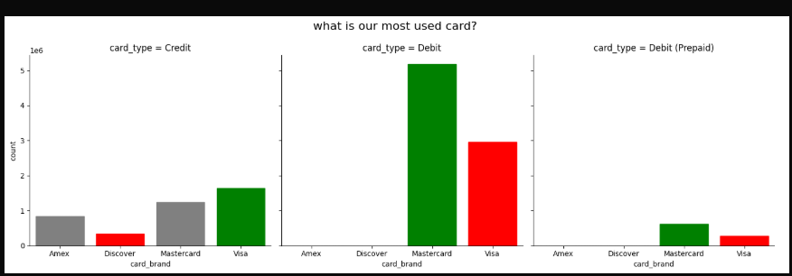
cards
Mastercard is the most used card both in # of transactions and sum of total amount.

Slide 9
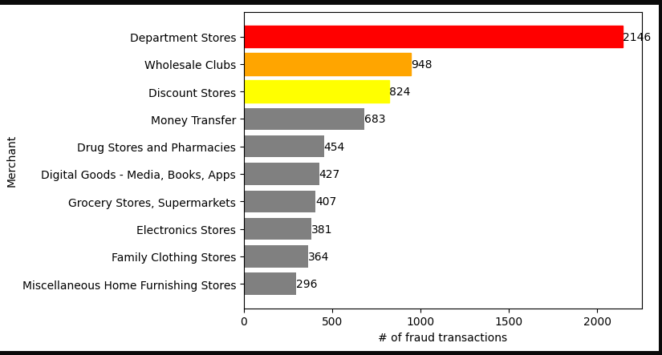
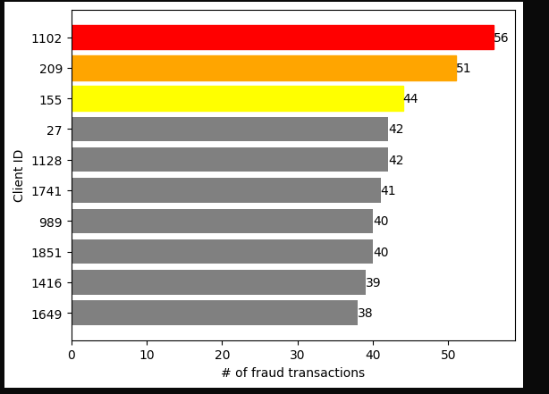
FRAuD
Most fraud transactions went towards Department Stores, and Wholesales Clubs, as most people target gift cards.
Client ID 1102 faced the most # of fraud transactions

Slide 10
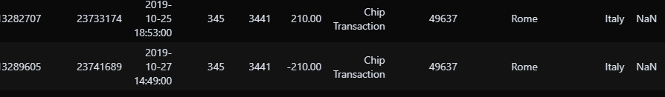
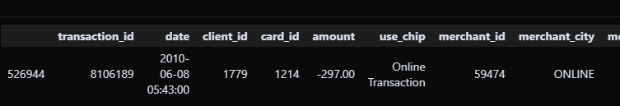

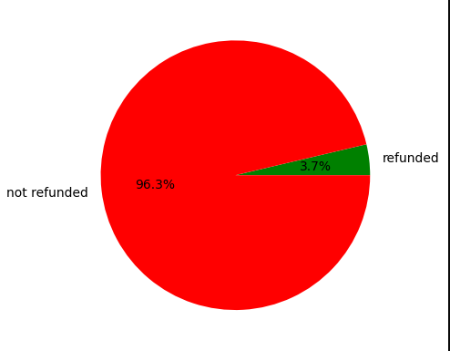
Some of in tranasctions are refund for fraud and out of these charges, only 3.7% were refunded.

Slide 11
Dashboard is included within project folder
Following pages are some code/technical stuff you can check if you are interested.

Slide 12
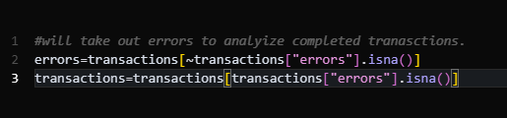
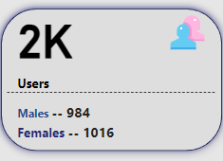
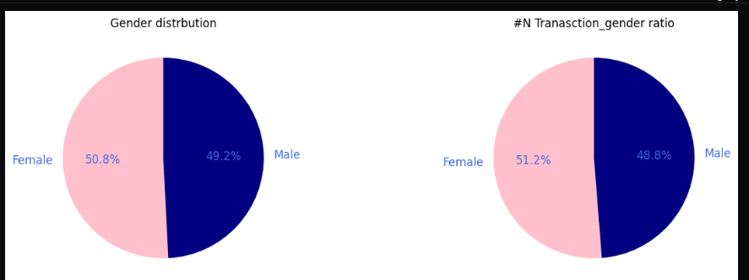
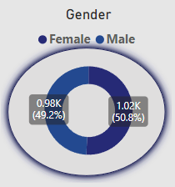
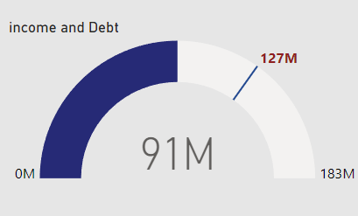
Removed errors early on, but they don’t realyy represent a huge chunk of data, so left them on dashboard

Slide 13
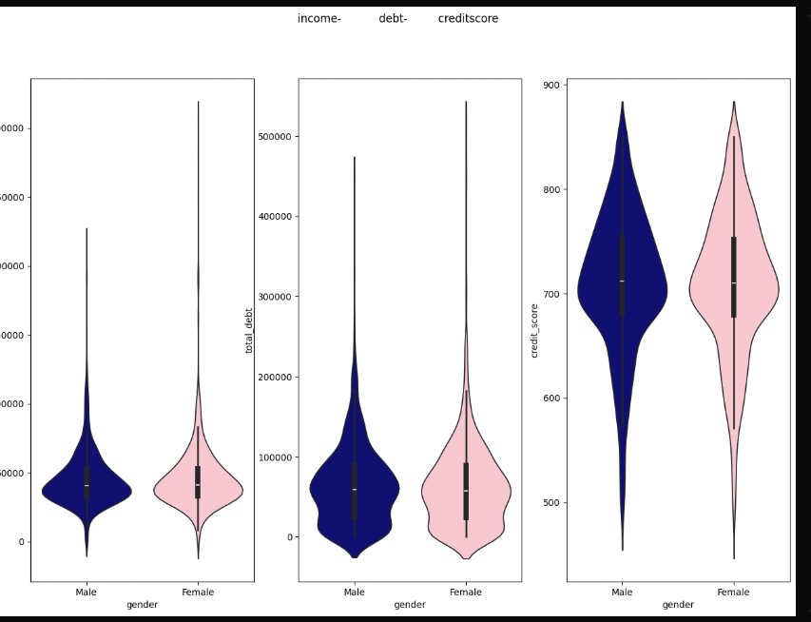
Distribution of (income –debt – credit score) --outliers can be observed specially within female group

Slide 14
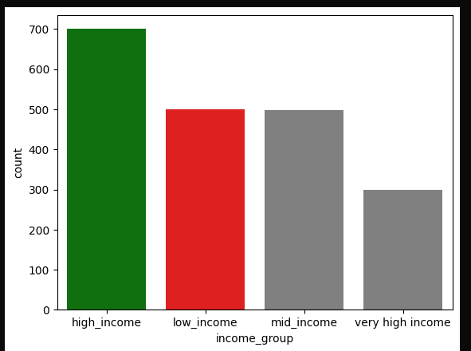
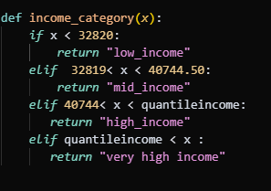
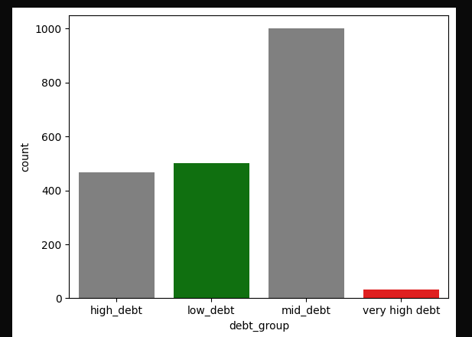
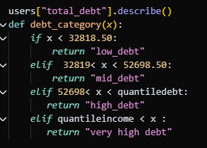
Defining debt categories and income group –Most of our users are in mid debt

Slide 15
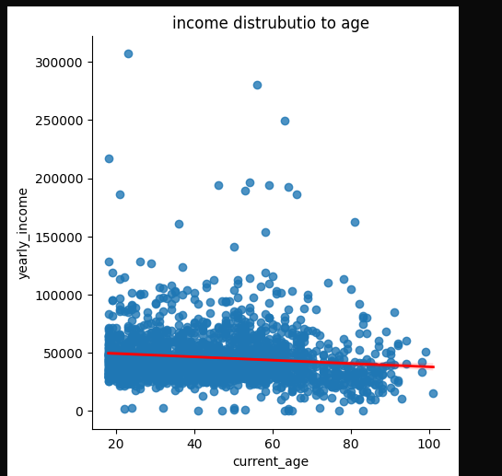
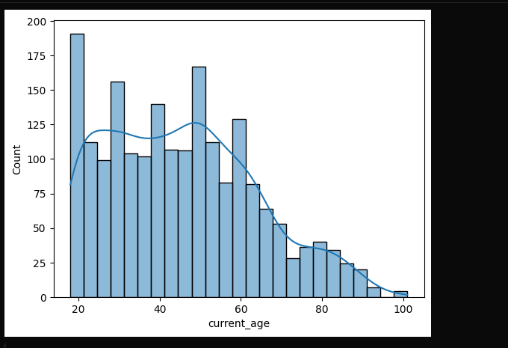
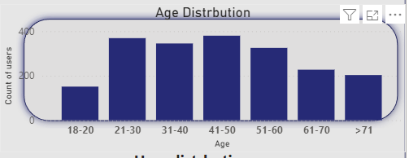
Age distrbution

